Slide 1




Supply Chain Operation Data Analysis Using Excel
STUDENT NAME : MUKESH.S
REGISTER NO : 422200017
DEPARTMENT : B.COM[ISM]
COLLEGE : S.I.V.E.T COLLEGE

Slide 2
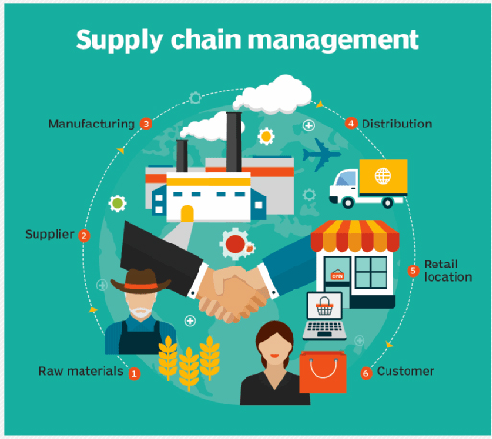
SUPPLY CHAIN OPERATION

Slide 3


AGENDA
Problem Statement
Project Overview
End Users
Our Solution and Proposition
Dataset Description
Modelling Approach
Results and Discussion
Conclusion
3/21/2024 Annual Review

Slide 4

PROBLEM STATEMENT
Certainly! A problem statement in supply chain operations outlines a specific issue that affects efficiency, cost, or service levels.
"Effective supply chain management is hindered by numerous inefficiencies, including inaccurate demand forecasting, inadequate inventory management, and unreliable supplier networks.

Slide 5

PROJECT OVERVIEW
This supply chain optimization project aims to streamline [Company Name]'s supply chain operations to reduce costs, enhance efficiency, and improve customer satisfaction. The project scope includes analyzing and optimizing supply chain network design, inventory management, logistics, procurement, and warehouse operations. Key objectives include reducing operational costs by 10-15%, improving delivery times by 20-25%, and increasing supply chain visibility.

Slide 6

WHO ARE THE END USERS?
In supply chain operations, the end users can vary based on the specific context, but generally include the following:
CustomersSales and Marketing TeamsWarehouse and Fulfillment StaffLogistics and Distribution PersonnelSuppliers and Vendors Inventory Managers Finance Teams IT Departments
Executives and Decision Makers

Slide 7
OUR SOLUTION AND ITS VALUE PROPOSITION
Our solution for optimizing supply chain operations centers on integrating advanced technology, enhancing sustainability, and improving visibility and agility. By implementing real-time inventory management systems and leveraging data analytics, we enable businesses to forecast demand accurately and minimize waste. Our approach prioritizes eco-friendly practices, such as green logistics and sustainable sourcing, to align with modern environmental standards. We emphasize end-to-end supply chain visibility through collaboration tools, ensuring proactive management of disruptions.

Slide 8
Dataset Description
The dataset for our supply chain operation analysis includes comprehensive information on various aspects of the supply chain process, encompassing inventory levels, order history, supplier performance, and logistics metrics. Specifically, it consists of transaction records detailing order quantities, delivery times, and fulfillment accuracy, alongside inventory turnover rates and stockout occurrences. Additionally, supplier data, such as lead times, pricing, and reliability ratings, provides insights into procurement efficiency.

Slide 9
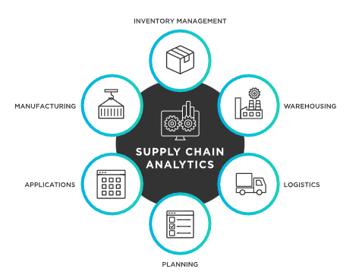

THE "WOW" IN OUR SOLUTION
3/21/2024 Annual Review

Slide 10
MODELLING
Modeling in supply chain operations involves creating structured representations of the supply chain to analyze and optimize its performance. This includes various types of models, such as descriptive models that outline current processes, predictive models that forecast demand and supply trends, and prescriptive models that provide actionable recommendations for improving efficiency. Key components of modeling include network design, inventory management, and transportation logistics, often utilizing techniques like discrete event simulation and linear programming.

Slide 11
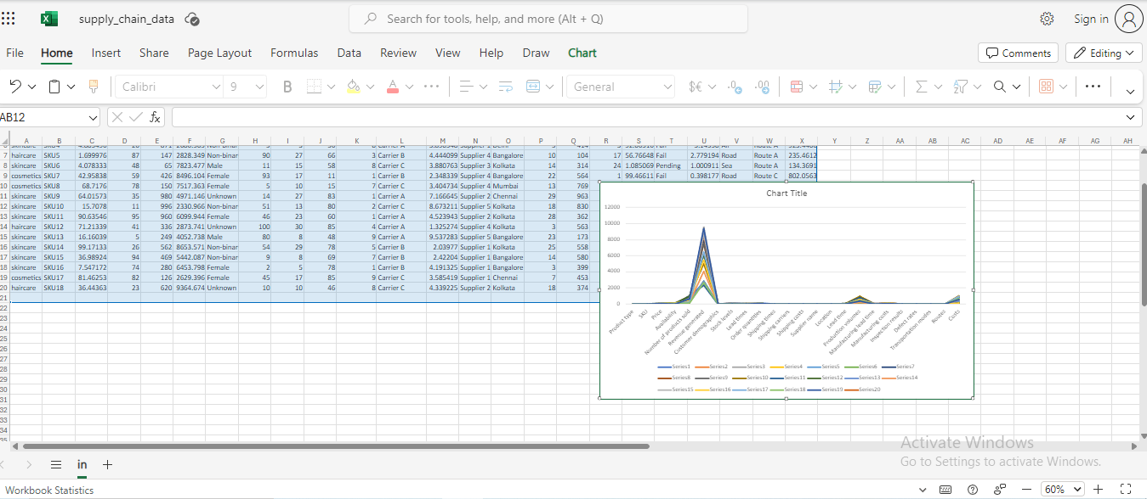
RESULTS

Slide 12
conclusion
Effective supply chain operations are critical to an organization's success, driving business growth, customer satisfaction, and competitive advantage. By Problem
Statement Project Overview End Users Our Solution and Proposition Dataset Description Modelling Approach Results and Discussion

